Slide 1
Safe Sanctuaries
Notes:
DO:
Welcome participants and introduce yourself. We recommend passing out copies of your policy and procedures or pointing participants to where they can find them.
[ADVANCE SLIDE]

Slide 2
What is Safe Sanctuaries?
Notes:
SAY:
Who can tell me what is included in the scope of Safe Sanctuaries?
DO: Invite participants to respond.
Correct answer examples:
Protections against child and elder abuse
Incorrect answer examples:
Emergency preparedness for natural disasters or active shooter situations
Conceal weapon policy
[ADVANCE SLIDE]

Slide 3
What is
Safe Sanctuaries?
Protection for children, youth, and vulnerable adults
Safety and accountability measures for employees and volunteers to protect against false accusations
Procedural standards by which we engage in ministry
Notes:
SAY:
Safe Sanctuaries is a set of guidelines in The United Methodist Church by which we provide:
Protection for children, youth, and vulnerable adults
Safety and accountability measures for employees and volunteers to protect against false accusations
Procedural standards by which we engage in ministry
[ADVANCE SLIDE]

Slide 4
What is
NOT
Safe Sanctuaries?
Concealed weapons policy
Comprehensive safety plan, such as lockdown procedures or building security
Emergency preparedness policy for tornados, earthquakes, fires, etc.
Notes:
SAY:
Safe Sanctuaries is not:
A concealed weapons policy
A comprehensive safety plan
An emergency preparedness policy
These types of policies are under the purview of the Board of Trustees.
DO: If your church has these policies/plans in place, point participants to where they can find them.
[ADVANCE SLIDE]

Slide 5
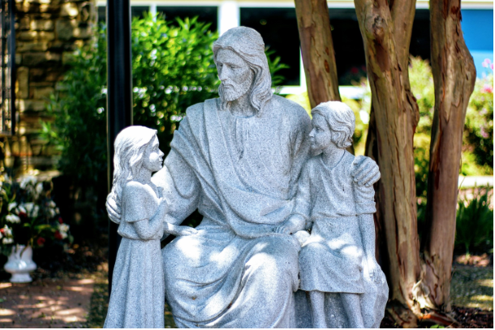
Biblical Mandate
Let the little children come to me. (Matthew 19:4)
When you welcome one of these children because of me, you welcome me. It will be terrible for people who cause even one of my little followers to sin. Those people would be better off thrown into the deepest part of the ocean with a heavy stone tied around their necks! (Matthew 8:6)
Notes:
DO:
Invite a participant to read the scripture on the screen for the class.
SAY: Scripture shares with us that Jesus himself included children in the community of faith and expected adults to treat them respectfully. Jesus is clear. We are called to love and protect the vulnerable. Safe Sanctuaries is a response to that calling.

Slide 6
Baptismal Pledge
Will you nurture these children/persons in Christ’s holy church,
that by your teaching and example they may be guided
to accept God’s grace for themselves,
to profess their faith openly,
and to lead a Christian life?
Will you nurture one another in the Christian faith and life and include these persons now before you in your care?
With God’s help we will proclaim the good news
and live according to the example of Christ.
We will surround these persons with a community of love and forgiveness, that they may grow in their trust of God,
and be found faithful in their service to others.
We will pray for them, that they may be true disciples
who walk in the way that leads to life. (UMH Baptismal Covenant I)
Notes:
SAY: The text on the screen is taken from the United Methodist Hymnal. In the Sacrament of Baptism, we make a pledge to order our lives after the example of Christ so that each child will be surrounded by steadfast love and confirmed and strengthened in the way that leads to live eternal. Safe Sanctuaries is one way that we live into this pledge.

Slide 7
WNCC & UMC Resolutions
In 1996, the General Conference passed a resolution calling on all United Methodist churches and ministries to create and implement procedures for the protection of children and youth. (Reducing the Rise of Child Sexual Abuse in the Church, 2016 Book of Resolutions #3084)
In the Western NC Conference, churches are required to have a Safe Sanctuaries policy and procedures. Although there are not requirements for what should be included in the policy or procedures, the conference does offer best practices.
Notes:
SAY: In 1996, the General Conference of the United Methodist Church – our denomination’s top legislative body – passed a resolution calling on all churches and ministries to create and implement procedures for the protection of children and youth.
All churches in the Western North Carolina Conference are required to have a Safe Sanctuaries policy and procedures by which they conduct ministry for and with children, youth and vulnerable adults—even if they don’t currently serve those populations. Although there are not requirements for what should be included in the policy or procedures, the conference does offer best practices.

Slide 8
What is the difference between a policy and procedures?
Notes:
SAY:
Before we move on, who can tell me the different between policies and procedures?
DO: Invite participants to respond.
[ADVANCE SLIDE]

Slide 9
POLICY
What? Who? Why?
PROCEDURES
How?
Notes:
SAY:
The policy should state the what, the who and the why. Who are we protecting, and why? The procedures should outline the how, including detailed, practical measures that our church takes to implement and uphold our policy.
SAY:
Why do we need both a policy and procedures?
DO: Invite participants to respond.
[ADVANCE SLIDE]

Slide 10
Our Policy
Two Adults
Two adults, at least one of which is safe sanctuary approved, should be in any room with youth and/or children.
Off site events: If children and youth, of both female and male gender, are present, then there must be an adult of the same gender for each represented.
Married couples count as one adult for safe sanctuary.
Notes:
PREPARE:
Add key points.
Add as many slides as needed.
DO: Share your church’s policy.
[ADVANCE SLIDE]

Slide 11
Our Policy
Age Limits
Staff and volunteers shall be at least 5 years older than the oldest child/youth being supervised. No one under the age of 18 shall be given singular supervisory capacity.
Visibility in rooms
There will be a window in the door, or a half door, that gives visibility to all areas of that room.
If there is no window, the door must be left open.
Notes:
PREPARE:
Add key points.
Add as many slides as needed.
DO: Share your church’s policy.
[ADVANCE SLIDE]

Slide 12
Our Policy
Counseling
Staff and Pastoral counseling is expected to be confidential in nature, but it is for the protection of both parties that such sessions take place where other people are nearby.
Notes:
PREPARE:
Add key points.
Add as many slides as needed.
DO: Share your church’s policy.
[ADVANCE SLIDE]

Slide 13
Our Policy
Transportation
Anyone driving youth or children in a church sponsored activity event must be an approved as a safe sanctuary driver.
Two unrelated adults in any car with children under the age of 13 whenever possible.
No child or youth should be alone with one adult at any time.
No youth may drive or transport others to church activities.
Notes:
PREPARE:
Add key points.
Add as many slides as needed.
DO: Share your church’s policy.
[ADVANCE SLIDE]

Slide 14
Our Policy
Insurance
St. Francis will maintain adequate insurance coverage, including the premises, liability, and sexual misconduct. Coverage is for activities on and off the premises.
Personal vehicles are required to maintain adequate insurance coverage.
Notes:
PREPARE:
Add key points.
Add as many slides as needed.
DO: Share your church’s policy.
[ADVANCE SLIDE]

Slide 15
How prevalent is child abuse ?
Notes:
SAY:
So, why does this matter to us today? How prevalent is child and elder abuse today? Does anyone know any of the statistics?
DO: Invite participants to respond.
[ADVANCE SLIDE]

Slide 16
51.0% of girls and 48.6% of boys will be abused before they turn 18.
.
Notes:
SAY:
According to a 2019 report from the Administration for Children and Families, which is under the umbrella of the U.S. Department of Health and Human Services, 51.0% of girls and 48.6% of boys will be abused before they turn 18.
(https://www.acf.hhs.gov/sites/default/files/cb/cm2017.pdf)
Ten percent of Americans aged 60 or older have experience some form of elder abuse, including physical abuse, psychological or verbal abuse, sexual abuse, financial exploitation, and neglect.
(Lachs, M., & Pillemer, K. (2015). Elder abuse. New England Journal of Medicine, 373, 1947–56. doi: 10.1056/NEJMra1404688)
[ADVANCE SLIDE]

Slide 17
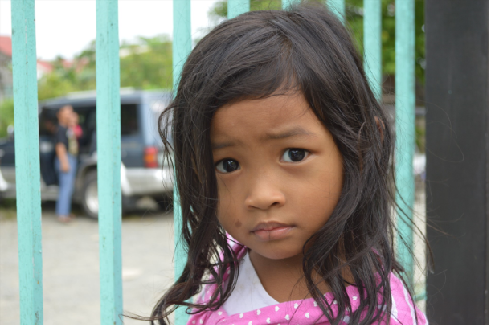
Types of child abuse
Neglect
Physical Abuse
Emotional Abuse
Ritual Abuse
Sexual Abuse
Notes:
SAY: Let’s look at the various types of child abuse.
[ADVANCE SLIDE]

Slide 18
Types of child abuse
Neglect is a lack of supervision to the degree that the person’s health, safety and well-being are threatened with harm.
Physical Abuse
Emotional Abuse
Ritual Abuse
Sexual Abuse
Notes:
SAY: Neglect is a lack of supervision to the degree that the person’s health, safety, and well-being are threatened with harm.
[ADVANCE SLIDE]

Slide 19
Types of child abuse
Neglect is a lack of supervision to the degree that the person’s health, safety and well-being are threatened with harm.
Physical Abuse is any intentional act causing injury or trauma by way of bodily contact.
Emotional Abuse
Ritual Abuse
Sexual Abuse
Notes:
SAY: Physical abuse is any intentional act causing injury or trauma by way of bodily contact.
[ADVANCE SLIDE]

Slide 20
Types of child abuse
Neglect is a lack of supervision to the degree that the person’s health, safety and well-being are threatened with harm.
Physical Abuse is any intentional act causing injury or trauma by way of bodily contact.
Emotional Abuse is characterized by a person subjecting or exposing another person to behavior that may result in psychological trauma.
Ritual Abuse
Sexual Abuse
Notes:
SAY: Emotional abuse is characterized by a person subjecting or exposing another person to behavior that may result in psychological trauma.
[ADVANCE SLIDE]

Slide 21
Types of child abuse
Neglect is a lack of supervision to the degree that the person’s health, safety and well-being are threatened with harm.
Physical Abuse is any intentional act causing injury or trauma by way of bodily contact.
Emotional Abuse is characterized by a person subjecting or exposing another person to behavior that may result in psychological trauma.
Ritual Abuse is sexual abuse or murder of people supposedly committed as part of a religious ritual.
Sexual Abuse
Notes:
SAY: Ritual abuse is sexual abuse or murder of people supposedly committed as part of a religious ritual.
[ADVANCE SLIDE]

Slide 22
Types of child abuse
Neglect is a lack of supervision to the degree that the person’s health, safety and well-being are threatened with harm.
Physical Abuse is any intentional act causing injury or trauma by way of bodily contact.
Emotional Abuse is characterized by a person subjecting or exposing another person to behavior that may result in psychological trauma.
Ritual Abuse is sexual abuse or murder of people supposedly committed as part of a religious ritual.
Sexual Abuse is intentional sexualized behavior involving a child for the adult’s own purposes.
Notes:
SAY: Sexual abuse is intentional sexualized behavior involving a child for the adult’s own purposes.
[ADVANCE SLIDE]

Slide 23
What is the most common form of child abuse?
Notes:
SAY:
Now that you know about the various types of child abuse, do you know what is the most common?
DO: Invite participants to respond.
SAY:
Although sexual assault cases get the most media coverage, neglect is the most common form of child abuse, followed by physical abuse.
Four risk factors that have been identified are:
Alcohol abuse
Drug abuse
Financial problems or an inability to provide sufficient financial resources to meet minimum needs
Domestic violence between any members of the household or family
(https://www.childwelfare.gov/pubPDFs/canstats.pdf, https://www.acf.hhs.gov/sites/default/files/cb/cm2017.pdf)

Slide 24
Although sexual assault cases get the most media coverage, neglect is the most common form of child abuse, followed by physical abuse.

Slide 25
What are signs of child abuse?
Notes:
SAY:
How can you spot child abuse? What are signs of child abuse?
DO: Invite participants to respond.
SAY:
The following signs might be signs of abuse:
The child:
Shows sudden changes or extremes in behavior
Has learning or concentration problems that cannot be attributed to specific physical or psychological causes
Has unexplained injuries
Has not received help for physical or medical problems brought to the parents’ attention
Is always watchful, as though preparing for something bad to happen
Lacks adult supervision
Lacks sufficient clothing for the weather
Is overly compliant, passive or withdrawn
Comes to church or activities early, stays late and does not want to go home
Is frequently absent
Shrinks at the approach of adults
Is reluctant to be around a particular person
Begs or steals food or money
Abuses animals or pets
The parent, caregiver or adult:
Blames the child for any problems
Asks you to use harsh physical discipline with the child
Has unrealistic expectations for the child
Is overly protective of the child or severely limits the child’s contact with others
Appears to be indifferent to the child
Constantly blames, belittles or berates the child
Offers conflicting, unconvincing or no explanation for the child’s injury, or provides an explanation that is not consistent with the injury
(https://www.childwelfare.gov/pubpdfs/whatiscan.pdf)
[ADVANCE SLIDE]

Slide 26
The following signs might be signs of abuse:
The child:
Shows sudden changes or extremes in behavior
Has learning or concentration problems that cannot be attributed to specific physical or psychological causes
Has unexplained injuries
Has not received help for physical or medical problems brought to the parents’ attention
Is always watchful, as though preparing for something bad to happen
Lacks adult supervision
Lacks sufficient clothing for the weather
Is overly compliant, passive or withdrawn
Comes to church or activities early, stays late and does not want to go home
Is frequently absent
Shrinks at the approach of adults
Is reluctant to be around a particular person
Begs or steals food or money
Abuses animals or pets

Slide 27
What are the risk factors associated with abuse?
Notes:
SAY:
It’s important to say that abuse is NEVER the victim’s fault or responsibility—whether the victim is a child, youth, adult, or elder. Risk factors have been identified, though, that are associated with the caregivers of children or vulnerable adults. What do you think these risk factors are?
DO: Invite participants to respond.
SAY:
Four risk factors that have been identified are:
Alcohol abuse
Drug abuse
Financial problems or an inability to provide sufficient financial resources to meet minimum needs
Domestic violence between any members of the household or family
(https://www.acf.hhs.gov/sites/default/files/cb/cm2017.pdf)
[ADVANCE SLIDE]

Slide 28
Four risk factors that have been identified are:
Alcohol abuse
Drug abuse
Financial problems or an inability to provide sufficient financial resources to meet minimum needs
Domestic violence between any members of the household or family

Slide 29
What should you do if you suspect or observe abuse?
Notes:
SAY:
You’ve noticed some signs of child or elder abuse. What do you do? Are you required to respond?
DO: Invite participants to respond.
SAY:
North Carolina law states that anyone who suspects or observes abuse must report it. So, what do you do?
If it is an emergency situation, call 911 immediately.
If you suspect abuse but you aren’t really sure… [Insert relevant information regarding your local church’s policy for this. Best practice is to report the suspicion to a staff person or clergy member, then together make a report to the police or to Child Protective Services. If the incident involves a clergy member, the District Superintendent should be notified.]
[ADVANCE SLIDE]

Slide 30
You’ve noticed some signs of child or elder abuse. What do you do? Are you required to respond?
North Carolina law states that anyone who suspects or observes abuse must report it. So, what do you do?
If it is an emergency situation, call 911 immediately.
If you suspect abuse but you aren’t really sure… Best practice is to report the suspicion to a staff person or clergy member, then together make a report to the police or to Child Protective Services. If the incident involves a clergy member, the District Superintendent should be notified.

Slide 31
Our Procedures
Registration and Permission forms for activities on the church property and special events like VBS, retreats, mission trips etc..
Adequate adult supervision for all church programming
Check-in for children at church events
Report any incidents to the Director
Notes:
PREPARE:
Add key points.
Add as many slides as needed.
DO: Share your church’s procedures. We recommend reviewing all procedures that apply to the training audience. (E.g., number of adult leaders in a room, physical boundaries, check in/out, incident forms, first aid, notifying parents/guardians, etc.)
[ADVANCE SLIDE]

Slide 32
Digital Conduct
Communicate with parents, guardians or caregivers
Create boundaries regarding “friending” or “following”
Be mindful of personal responses to posts
Phone records are available even if deleted from your device
Notes:
PREPARE:
This slide provides best practices. Edit slide, as needed, to match your church’s policy and procedures.
SAY:
First, when communicating with children, youth, or vulnerable adults, we will always keep the parents, guardians, and caregivers in the loop, too. Many youth have their own cell phones and email accounts, and it’s a good idea to text or email them with updates about upcoming events, etc. However, we will always copy their parents, guardians or caregivers so they’re aware of the communication, too. We will never communicate with a child, youth, or vulnerable adult in secret.
Secondly, it’s important to create and keep boundaries regarding friending or following children, youth, or vulnerable adults on social media platforms. A best practice that we like to follow is if THEY invite you to friend or follow them, or ask to friend or follow YOU, then you are welcome to do so. This is similar to physical contact. You should never initiate a hug with a child, youth, or vulnerable adult. However, if THEY initiate the hug, that’s great! You are never required to connect via social media, but if you would like to you may.
Next, be mindful of your personal posts and responses on social media platforms. We don’t seek to censor you, but we do want you to be mindful that your posts or the likes or comments you submit to someone else’s post might be visible to the children, youth, or vulnerable adults you serve or their parents, guardians, or caregivers. If you would be embarrassed for them to see something, don’t post it.
Finally, you need to know that phone records are available even if you’ve deleted them from your device. In cases of suspected abuse or misconduct, the police are able to recover these records.

Slide 33
Our Digital Expectations
First, when communicating with children, youth, or vulnerable adults, we will always keep the parents, guardians, and caregivers in the loop, too. Many youth have their own cell phones and email accounts, and it’s a good idea to text or email them with updates about upcoming events, etc. However, we will always copy their parents, guardians or caregivers so they’re aware of the communication, too. We will never communicate with a child, youth, or vulnerable adult in secret.
Secondly, it’s important to create and keep boundaries regarding friending or following children, youth, or vulnerable adults on social media platforms. A best practice that we like to follow is if THEY invite you to friend or follow them, or ask to friend or follow YOU, then you are welcome to do so. This is similar to physical contact. You should never initiate a hug with a child, youth, or vulnerable adult. However, if THEY initiate the hug, that’s great! You are never required to connect via social media, but if you would like to you may.
Notes:
PREPARE:
Add key points.
Add as many slides as needed.
DO: Share your church’s expectations for cell phone and online usage. Also include any restrictions on posting images or videos of children, youth, or vulnerable adults.
[ADVANCE SLIDE]

Slide 34
Upon completion of the Safe Sanctuary Presentation here, you must review the Policies and Procedures Section and submit your Application for Background Check. The application form is available in the church office or online that you can print. You can then either deliver it to the office or scan and email it to Michelle@stfrancischarlotte.org
Once your background check is approved, you are Safe Sanctuary Approved for a period of three (3) years with a new background check being required in five (5) years.

Slide 35
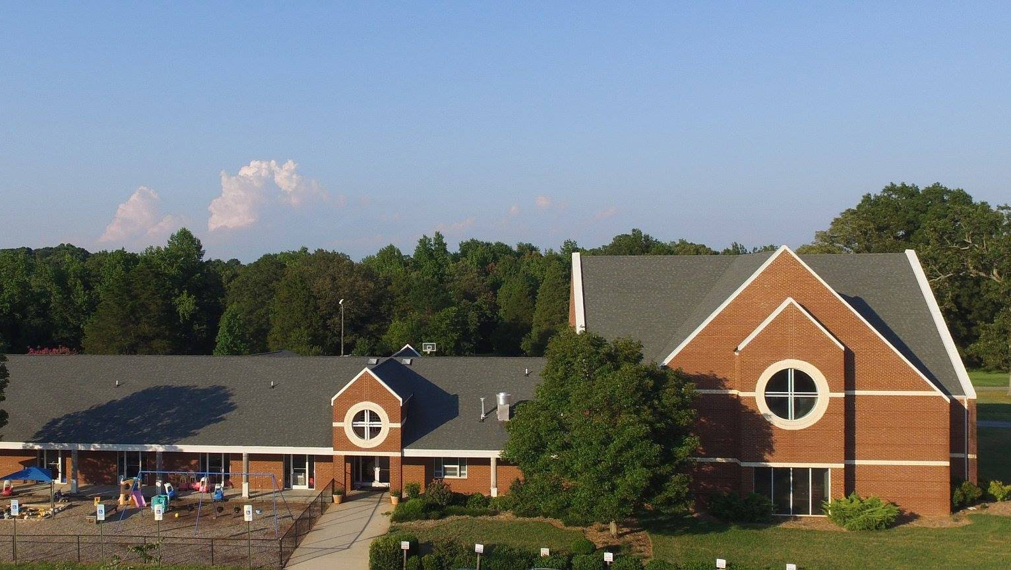
SAFE SANCTUARIES
Notes:
DO:
Thank participants for participating in this training and for the ways they serve children, youth, and vulnerable adults in your community!
[ADVANCE SLIDE]

